Slide 1
Petalinux and OpenCL
Adam Taylor

Slide 2
Session 1
Session 2
Session 3
Session 4
Introduction to Xilinx FPGA
Processing in Xilinx FPGA
Embedded Linux
Accelerating Solutions

Slide 3
History of PetaLinux
Linux was created as a free version of Unix for the x386 Intel CPU by Linus Torvalds in 1991
Linux was ported to ARM in 1994 on the Acorn processor which was not embedded
The first embedded project that Linux was ported to is unclear, it is believed to have been an x86 variant in 1997
2012 Xilinx acquires embedded Linux company: PetaLogix
PetaLinux first public release in 2013
Yocto build system utilized since version 2016.3

Slide 4
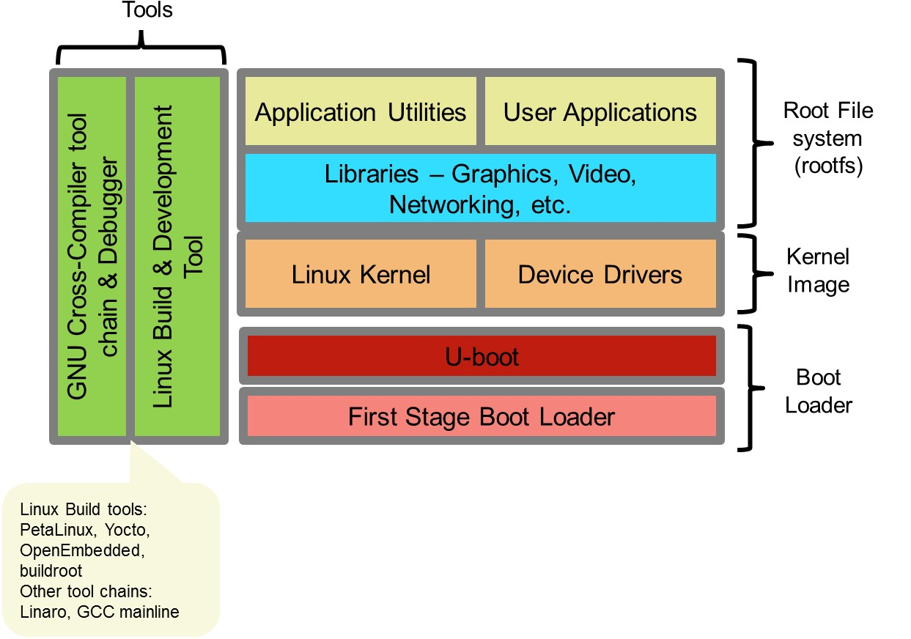
Linux Elements

Slide 5
What is PetaLinux? (a set of tools)
Petalinux Tools enable, build and customization of
First Stage Boot Loader
U-Boot (Second Stage Boot loader)
Linux Kernel and Device Tree
Root File System – User Applications, Libraries and Kernel Modules
PetaLinux is a build tool, all component can be built without PetaLinux if sufficiently experienced
Components from other build processes can be integrated

Slide 6
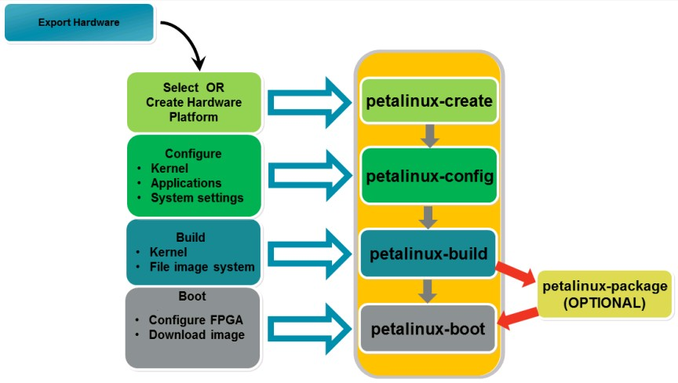
PetaLinux Tools Flow

Slide 7
Petalinux Multitasking Capabilities
Embedded Linux (like Linux) is a multi-tasking multi-user operating system
On the Arty Z7 there are two cores, on Gensys ZU there are four APU cores
Petalinux multitasking means:
Fast (Two, 32-bit or Four 64-bit cores) but not a real-time OS (RTOS)
If your application requires real-time, use the MicroBlaze or R5 cores. These core cannot run PetaLinux but can run FreeRTOS etc.
Communication between the A9, A53 (PetaLinux) and MicroBlaze, R5 (FreeRTOS etc.) can use OpenAMP
Even though PetaLinux is not a pure RTOS it can still be used for many applications (with careful system architecture, design and expectations)

Slide 8
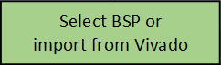
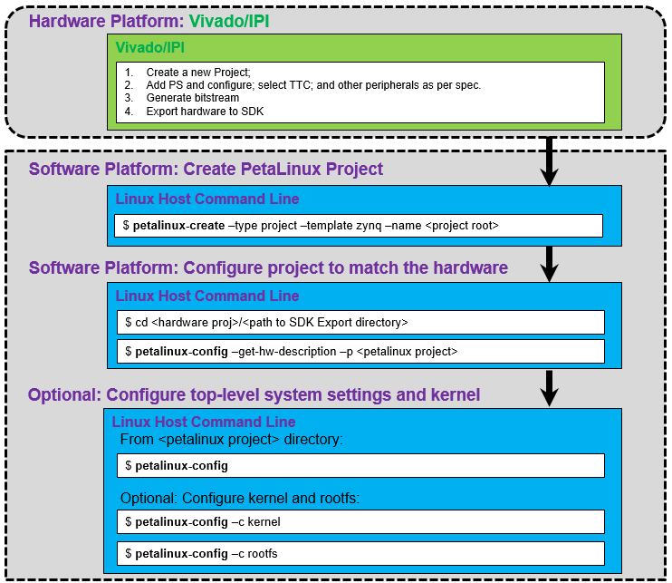
Creating a PetaLinux Project

Slide 9
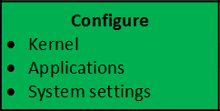
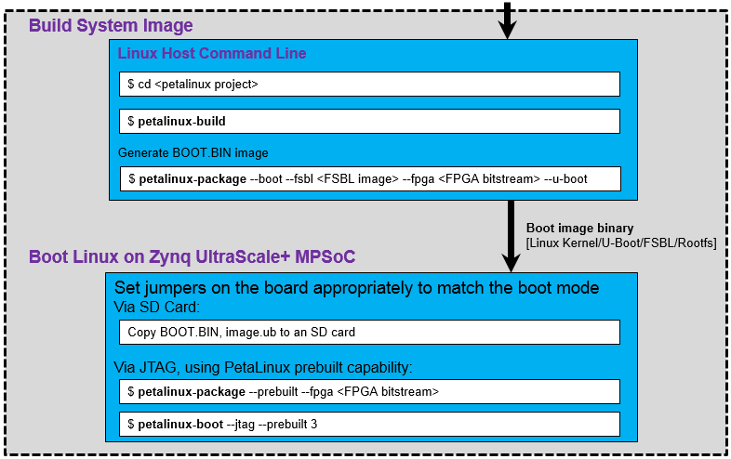
Configuring a PetaLinux Project

Slide 10
Vitis

Slide 11
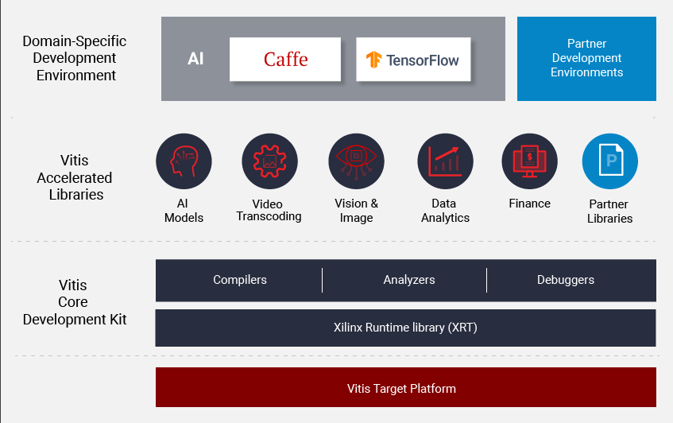
What is Vitis
Vitis is unified software development environment from Xilinx
Offers Unified edge and cloud development methodologies
Support embedded and accelerated flows

Slide 12
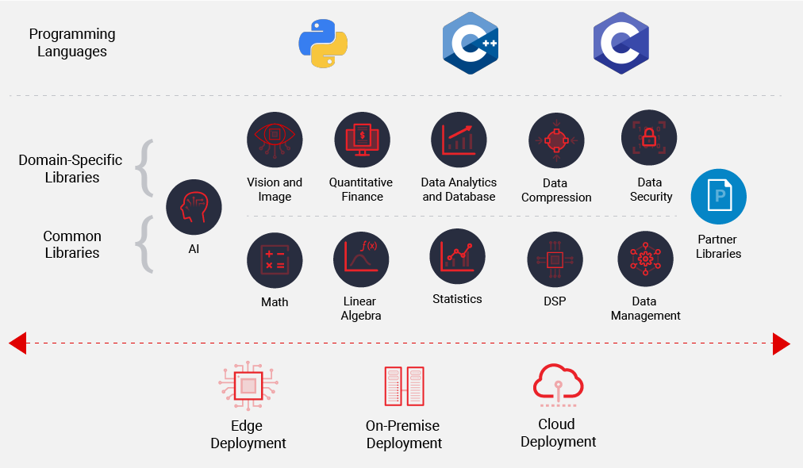
Vitis Accelerated Libraries
Several Open Source acceleration ready libraries
Common Libraries – offer a set of common functionality
Domain specific libraries – offer out of the box functions for specific domains e.g. vision

Slide 13

Vitis Core Development Kit
GUI & Command line tools for compilation, debug and analysis of C, C++ and OpenCL designs.
Can use preferred GUI or integrated GUI
Supports embedded and accelerated flows

Slide 14
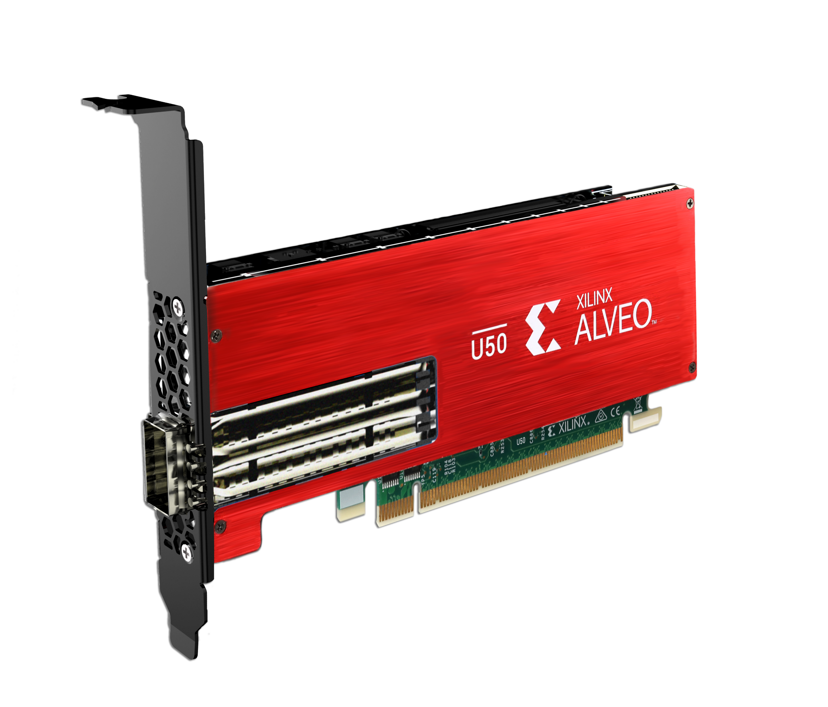
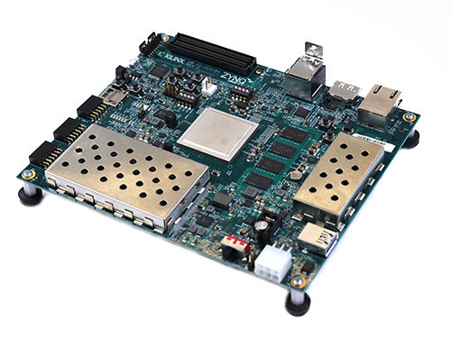
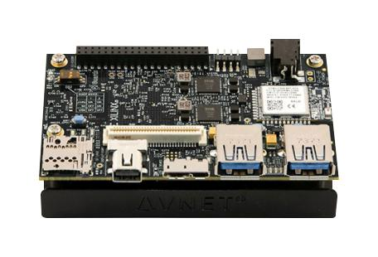
Vitis Target Platforms
Embedded
SoC – MPSoC, RFSoC, Zynq
FPGA – MicroBlaze
Cloud – Alveo / AWS F1 Instance
Embedded SoC and Cloud applications can use acceleration flow.
All required files and boot elements are generated

Slide 15
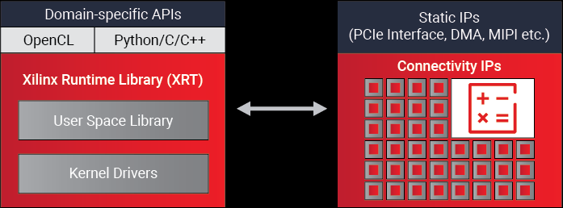
Xilinx Runtime library
Xilinx Runtime library (XRT) enables communication between the host and accelerator
Cloud based – Host x86
Embedded – Arm A9 or A53
Provides all libraries, APIs, drivers and utilities.

Slide 16
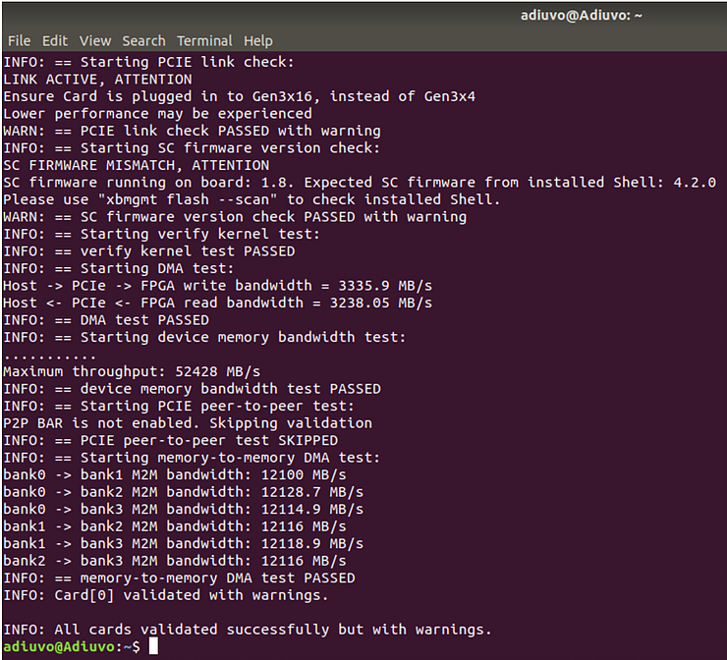
Xilinx Runtime library
Key Functions of the Runtime include
Downloading the FPGA binary
Memory Management between Host and Accelerator
Execution Management
Board Management

Slide 17
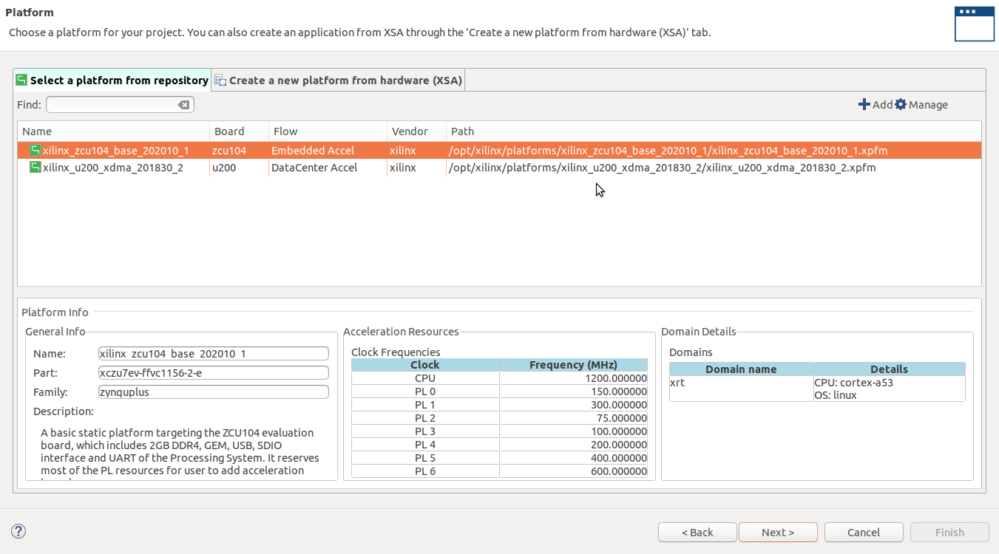
Element of Vitis
All projects required a platform
Hardware element – makes available AXI connections, clocks and Interrupts in the PL to Vitis Compiler
Software element – provides boot, XRT and QEMU support
Linux element – FS, Image and SysRoot

Slide 18
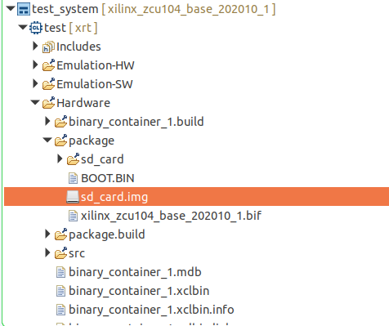
Vitis Output
Compiled binary (host) and XCLbin (accelerator)
Embedded System Output
SD Card Image
Image
File System
Binary and XCLBin
Cloud output
Binary and XCLBin

Slide 19
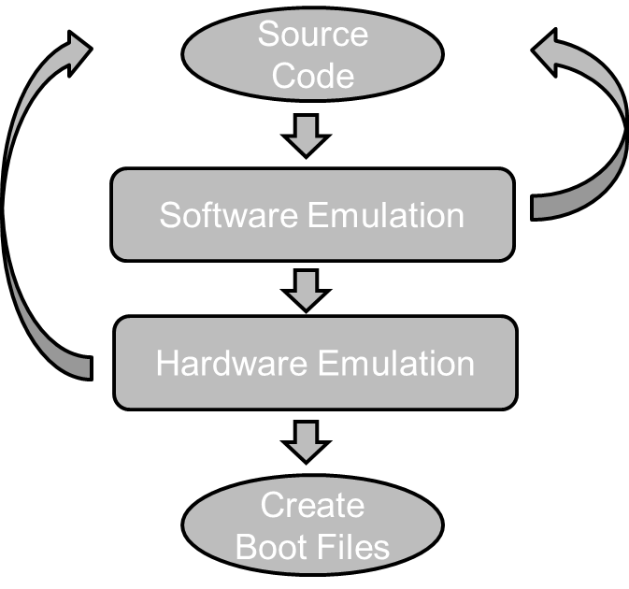
Vitis Development Flow
Software Emulation – Syntax errors & algorithm verification
Hardware Emulation – Optimize Performance, Interfacing & Resources

Slide 20
OPENCL

Slide 21

OpenCL Framework
1-
9
An open industry standard
For parallel computing
Of heterogeneous systems
Enables cross-platform functional portability
No code changes
Portable across CPU, GPU, FPGA, DSP, etc.
Can run on cell phones, laptops, super computers
Important: No performance portability
Wide market adoption
Support implemented by
Apple, AMD, Xilinx, Intel, ARM, Nvidia, Qualcomm, etc.
Many companies developing applications
Image, video, audio processing, scientific calculations, medical imaging, and more
Notes:
An open industry standard for parallel computing: ˃ OpenCL C language ˃ OpenCL API ˃ OpenCL run time The OpenCL framework standard is maintained by Khronos Group (khronos.org).

Slide 22
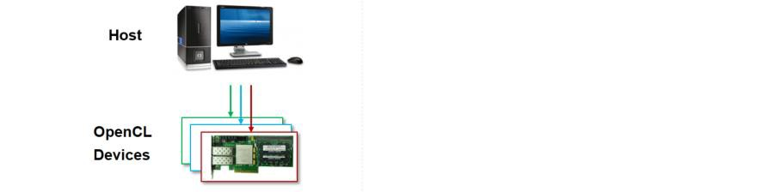
OpenCL Framework
1-
1
1
Platform model
Defines representation of ANY platform
Contains
Single host
One or more OpenCL devices (compute device)
Notes:
OpenCL platforms are defined by the grouping of a host processor and one or more OpenCL computing devices. The host processor, which runs the OS for the system, is also responsible for the general bookkeeping and task launch duties associated with the execution of OpenCL applications. The device is the hardware element in the system on which the computing kernels of an OpenCL application are executed.

Slide 23
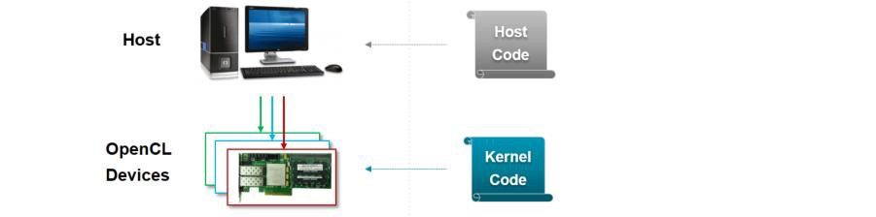
OpenCL Framework
1-
1
2
Platform model
Defines representation of ANY platform
Contains
Single host
One or more OpenCL devices (compute device)
Execution model
OpenCL application: Two parts
Host program
Manages the entire application: OpenCL APIs
Kernels (OpenCL C language)
Functions to accelerate, run on OpenCL devices
Notes:
Execution has two parts: ˃ Host program: runs on x86. ˃ Kernel: contains functions to accelerate and runs on OpenCL devices.

Slide 24
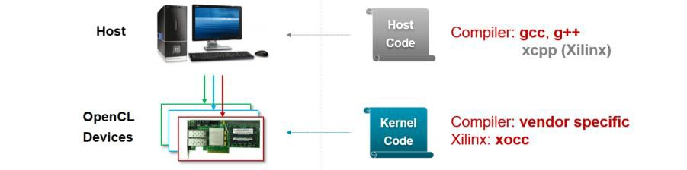
OpenCL Framework
V++
Platform model
Defines representation of ANY platform
Contains
Single host
One or more OpenCL devices (compute device)
Execution model
OpenCL application: Two parts
Host program
Manages the entire application: OpenCL APIs
Kernels (OpenCL C language)
Functions to accelerate: run on OpenCL devices

Slide 25
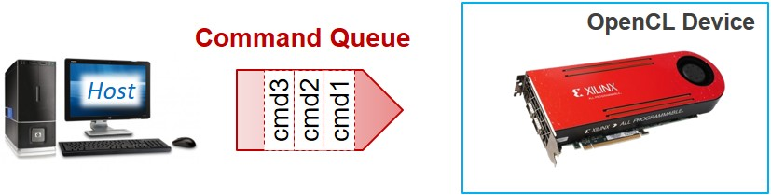
Execution Model – Command Queues
142337**slide
1-
1
1
Interaction between host and device occurs via command queues
Created by host
Attached to a single device
Note: Multiple command queues can be active within context
Three command types
Kernel execution commands
Memory commands
Transfer data between host and different memory objects
Synchronization commands
Put constraints on in the order in which commands are executed

Slide 26

Memory Model
142340**slide
1-
1
2
Three types of memory objects
Buffer objects
Contiguous block of memory
Available to kernels for read/write
Programmer can write data to buffers
Access to data via pointers
Image objects (not a part of embedded profile)
Hold images only
Storage/format can be optimized for specific OpenCL device
OpenCL framework provides functions to manipulate images
Pipes
Data organized as FIFO
Accessed (read/write) via built in
Pipe not accessible from the host

Slide 27
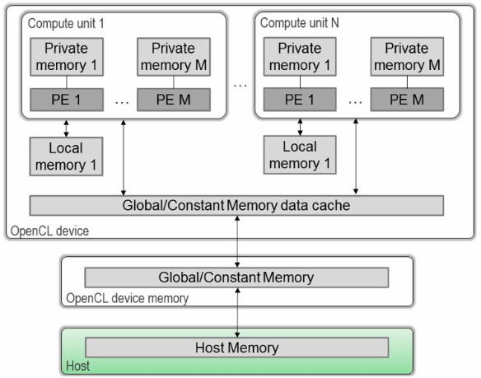
Five Sub-regions of Memory Objects
142343**slide
1-
1
3
Host memory
Visible to host only
OpenCL framework only defines how host memory interacts with OpenCL objects
Global memory
Visible to host and device
All work items in all workgroups can read/write there
Global on-chip memory – visible to device only
Constant memory
Region of global memory
Work items – read access only
Local memory
Local to workgroup (shared by all work-items in a group)
Private memory
Accessible by a work-item

Slide 28
High Level Synthesis

Slide 29
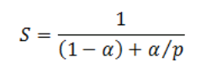
Amdahl's law
S: overall performance improvement
Alpha: percentage of the algorithm that can be sped up with hardware acceleration
1-alpha: percentage of the algorithm that cannot be improved.
p: is the speedup due to acceleration (%).
Set Alpha to 0.1 and select speed up - even with large acceleration P defined, speed up is close to 1
Set Alpha to 0.5 and select same speed up – close to factor of two improvement.

Slide 30
Getting the best from HLS
Functions we accelerate into logic often need optimising
Loops need unrolling
Memory Structures need optimising
Resource allocation
HLS controlled via #pragma in the accelerated function
Notes:
https://www.xilinx.com/support/documentation/sw_manuals/xilinx2018_1/ug1253-sdx-pragma-reference.pdf

Slide 31
Who has Used HLS before ?
HLS came of age over the last 5 years
HLS is excellent for data flow acceleration e.g. signal processing, image processing, Artificial Intelligence and Machine Learning
Scheduling
Binding
Control Extraction

Slide 32
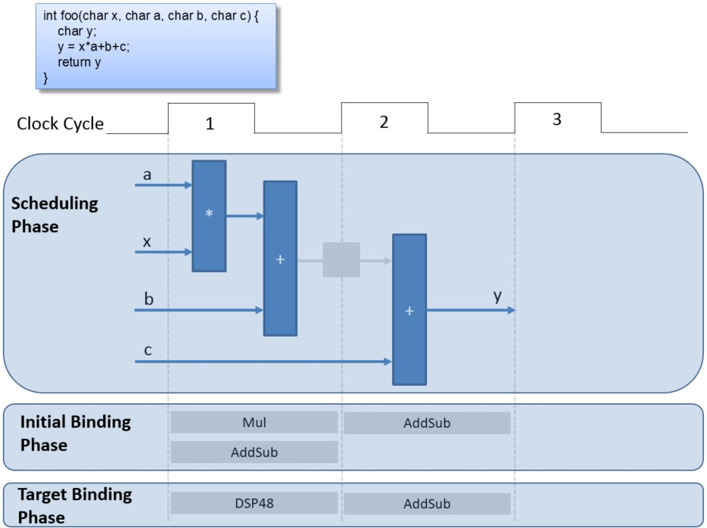
Example of HLS

Slide 33
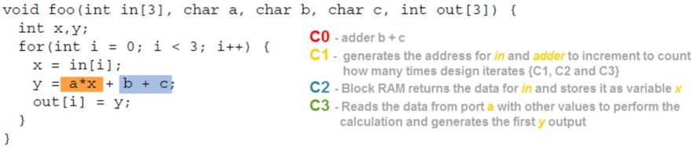
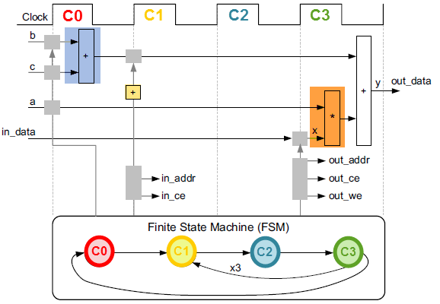
Looking a little deeper

Slide 34
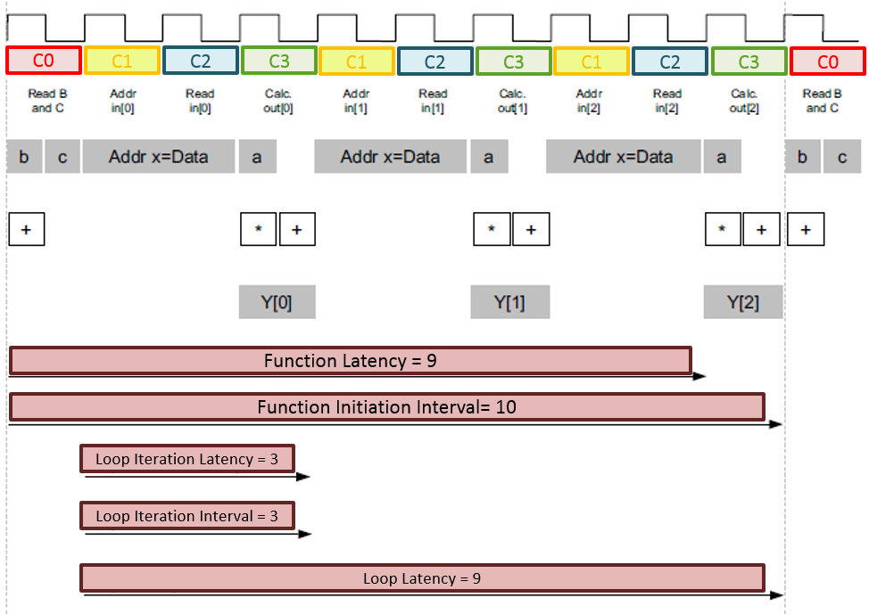
Terminology

Slide 35
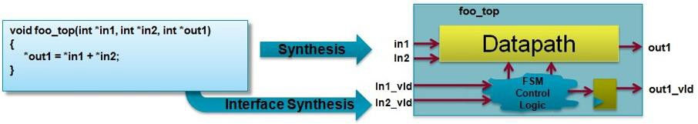
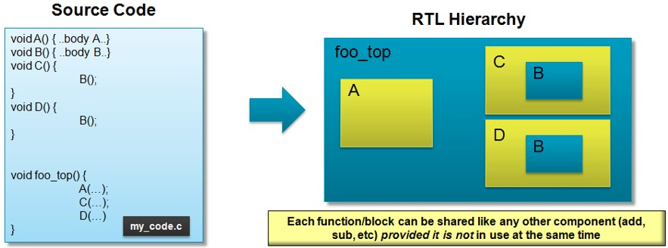
C to RTL
HLS synthesizes the C code in different ways
Top-level function arguments synthesize into RTL I/O ports
Loops in the C functions are kept rolled by default
C functions synthesizes into blocks in the RTL hierarchy
1
-
9
Arrays in the C code synthesize into block RAM in the final design

Slide 36
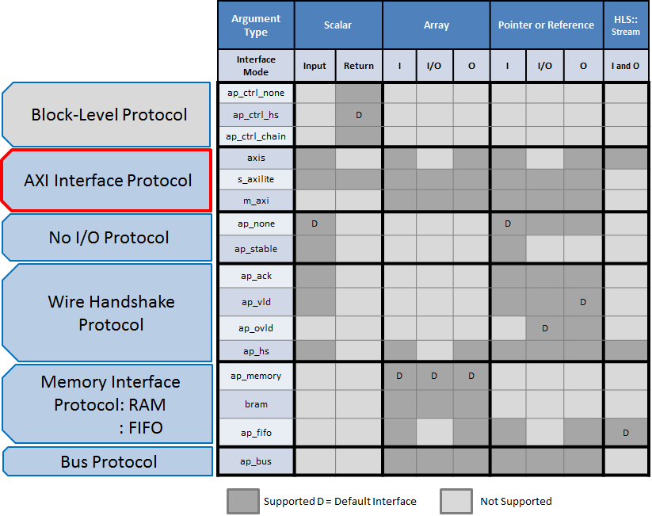
Interfacing

Slide 37
Optimization

Slide 38
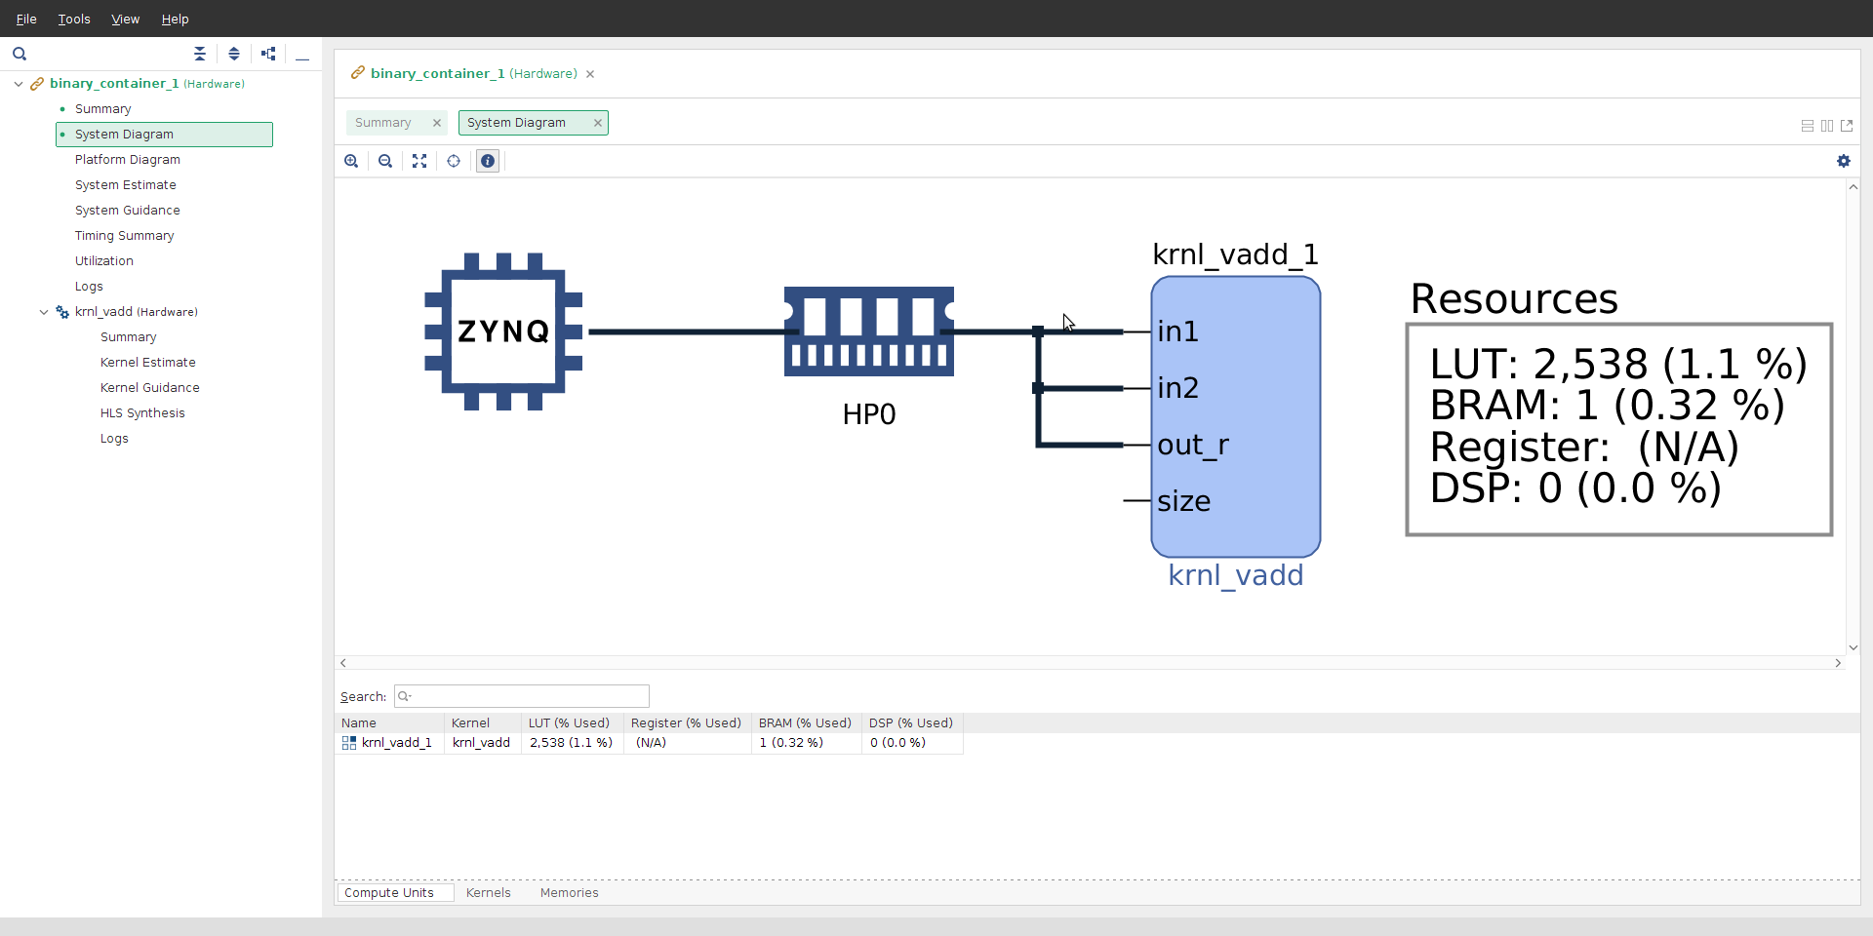
Optimization
Optimization Possible at both Host and Kernel
Enables most responsive solution
Host optimization
Kernel optimization possible in OpenCL and C/C++
Optimization Syntax differs

Slide 39
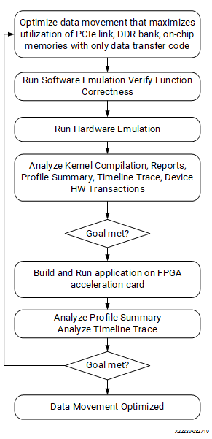
Host Optimization
Optimize the data movement in the application before optimizing computation
Compute Unit Scheduling
Multiple In-Order Command Queues
Single Out-of-Order Command Queue
Notes:
In the OpenCL API, all data is transferred from the host memory to the global memory on the device first and then from the global memory to the kernel for computation. The computation results are written back from the kernel to the global memory and lastly from the global memory to the host memory

Slide 40
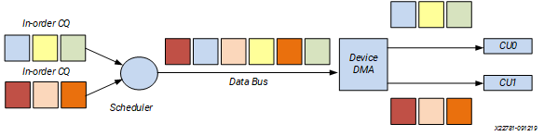
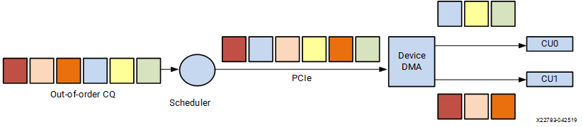
Host Optimization
Single Out-of-Order Command Queue
Multiple In-Order Command Queues

Slide 41
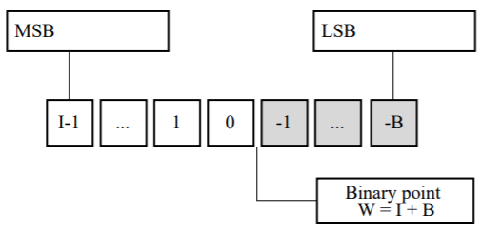
Kernel Optimization – Data Types
Avoid native C data types e.g. int, float, double
Best performance is using bit accurate types (C/C++ Kernels)
Arbitrary Precision Integer
Arbitrary Precision fixed point
Enables smaller & faster logic implementations

Slide 42
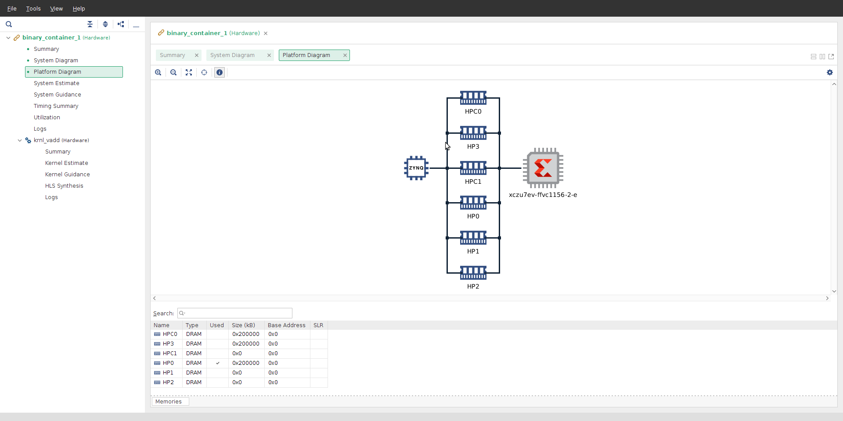
Kernel Optimization – Interfacing
Two types of data transfer
Data Pointers via global memory (M_AXI)
Scalar direct to kernel (AXI_LITE)
Vitis automatically selects interface type
Max data width is 512 bits – maximum performance leverages this

Slide 43
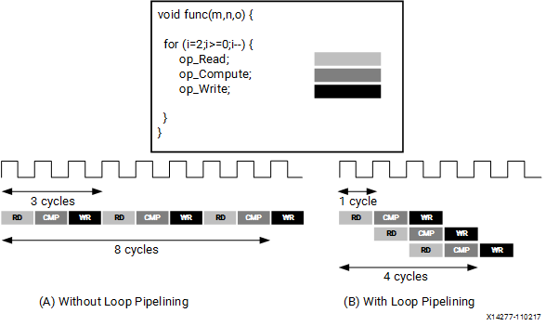
Kernel Optimization – Pipelining
By default, every iteration of a loop only starts when the previous iteration has finished
Pipelining the loop executes subsequent iterations in a pipelined manner

Slide 44
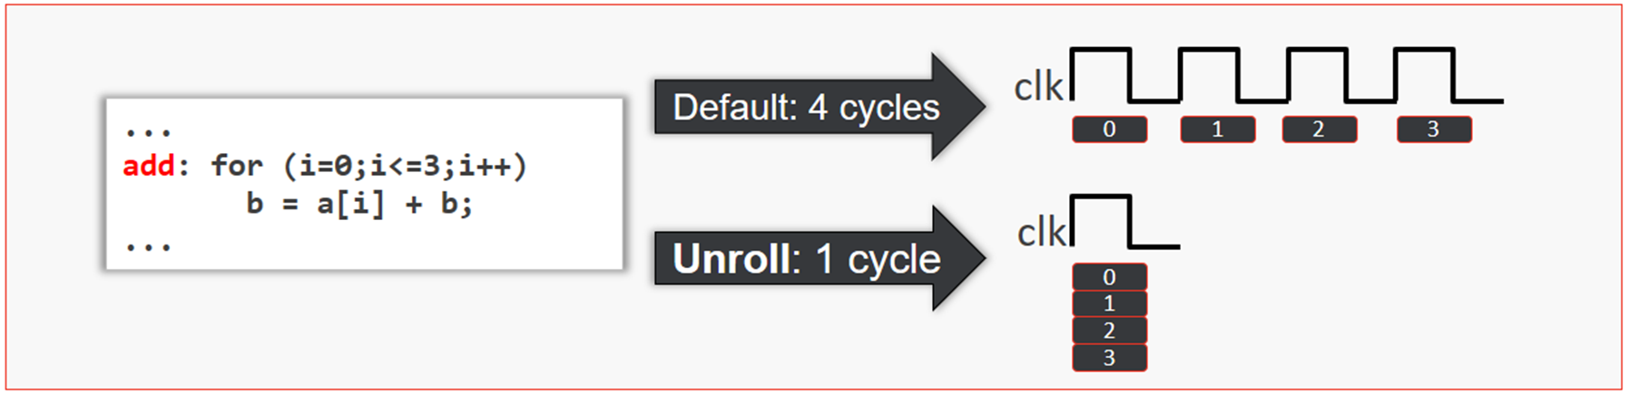
Kernel Optimization – Unrolling
Unrolling a loop enables the full parallelism
Full or Partial Unroll
Data dependencies in loops can impact the results of loop pipelining or unrolling

Slide 45
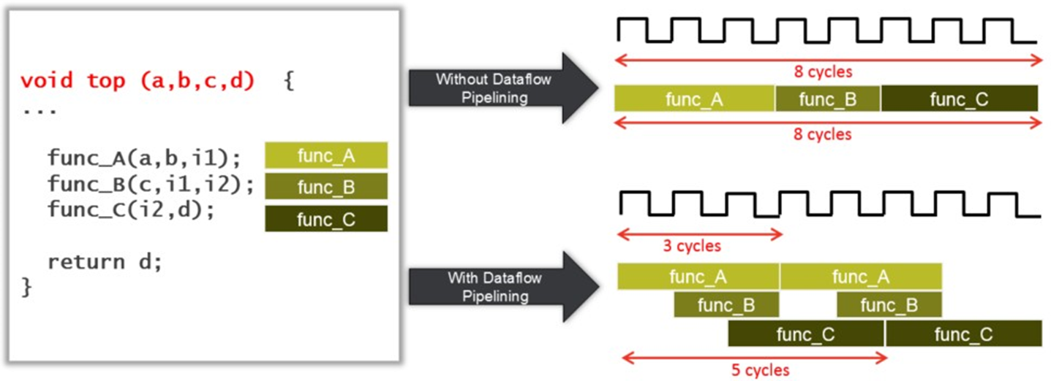
Kernel Optimization – DataFlow
Improve kernel performance by enabling task-level pipelining
Be careful of
Single producer-consumer violations.
Bypassing tasks.
Feedback between tasks.
Conditional execution of tasks.
Loops with multiple exit conditions or conditions defined within the loop

Slide 46
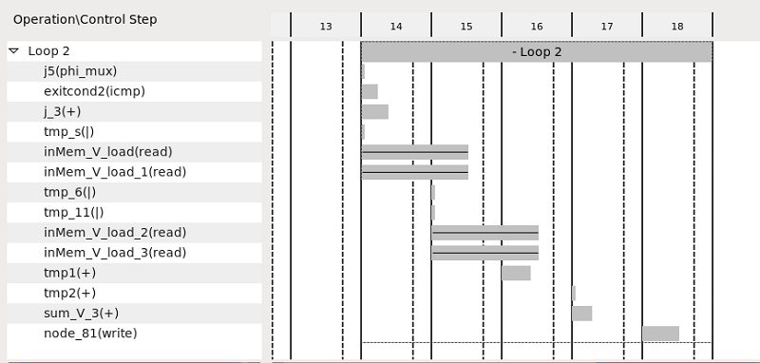
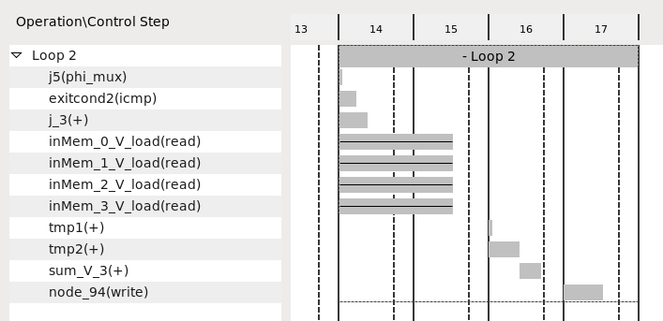
Kernel Optimization – Memory
Limited BRAM access bandwidth, can heavily impact the overall performance
Ability to partition and reshape arrays can increase bandwidth
Partition – Separates into different BRAMS
Reshape – allows combination of words

Slide 47
Kernel Optimization - Pragmas
Optimization | C/C++ | OpenCL
Pipeline | #pragma HLS PIPELINE | __attribute__((xcl_pipeline_loop))
Unroll | #pragma HLS UNROLL | __attribute__((opencl_unroll_hint))
DataFlow | #pragma HLS DATAFLOW | __attribute__ ((xcl_dataflow))
Memory | #pragma HLS ARRAY_PARTITION
Further information can be found at
https://www.xilinx.com/html_docs/xilinx2020_1/vitis_doc/optimizingperformance.html#fhe1553474153030

Slide 48
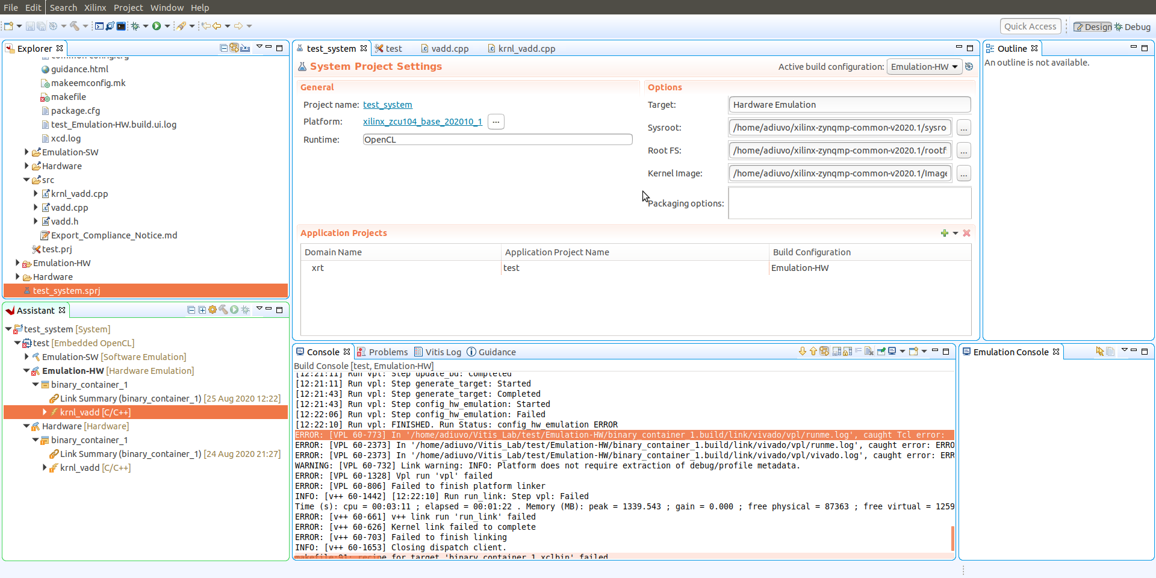
Vitis GUI – Project Settings

Slide 49
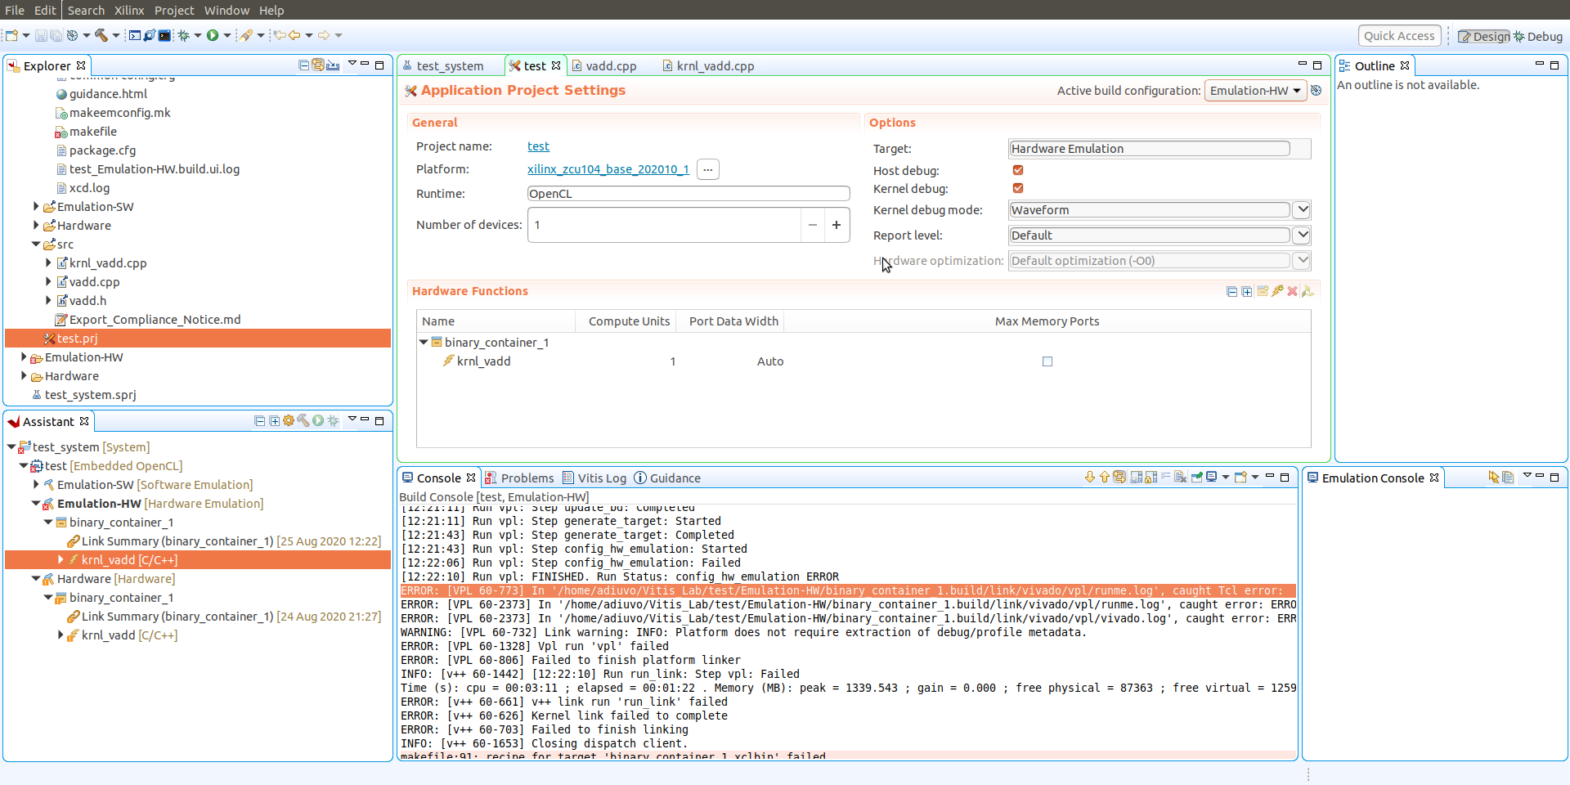
Vitis GUI – Project Setting

Slide 50
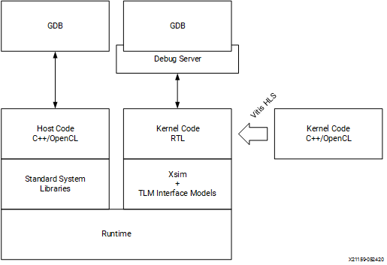
Vitis-Debug
Can Debug
Software Emulation
Hardware Emulation
Hardware flow insert ILA
Debugging will use QEMU and Logic Simulator

Slide 51


www.adiuvoengineering.com
adam@adiuvoengineering.com

